Slide 1
Banknote Authentication
Kwon, Logan,
Taeheon, Zhen

Slide 2
Agenda
Data Description
Descriptive Analysis
Model comparison
Conclusion
Notes:
Our presentation has 4 parts, Data Description, Descriptive, Model comparison, and the Conclusion.

Slide 3
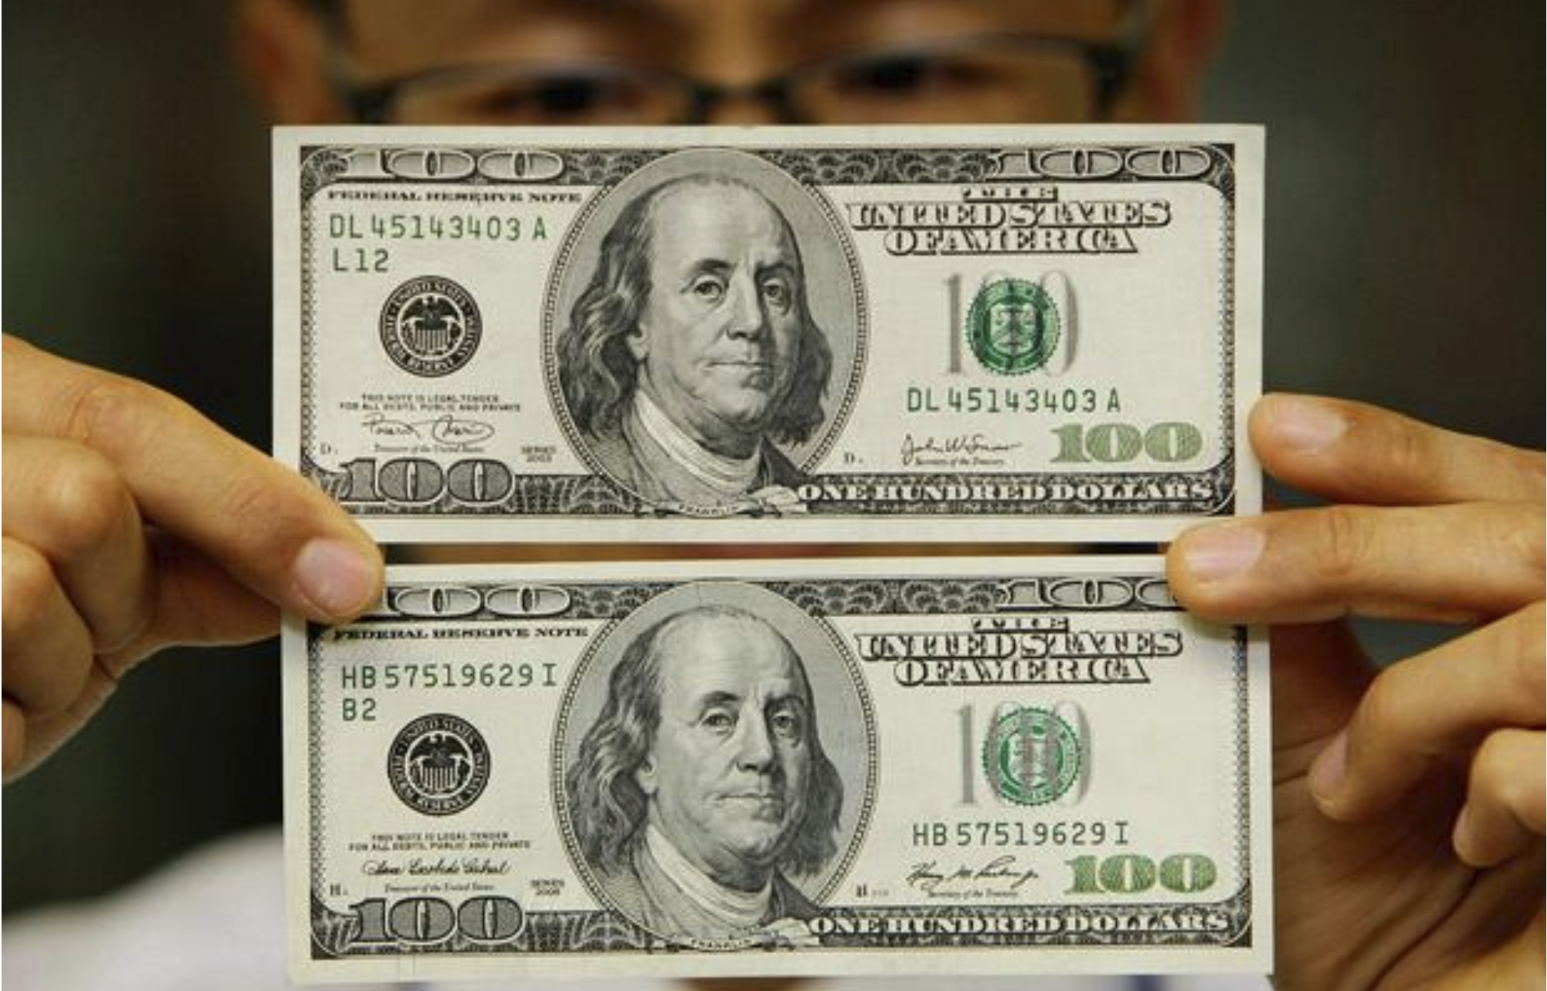
Notes:
Can you classify which one is the fake one? Actually, I don’t know. Differentiating the real banknote from the fake note is not easy as you can see. That’s why we need a help of machine learning.

Slide 4
Data Description
Variance of wavelet Transformed image | Continuous
Skewness of Wavelet Transformed image | Continuous
Kurtosis of Wavelet Transformed image | Continuous
Entropy of Wavelet Transformed image | Continuous
Class | Discrete (1 = fake, 0 = real )
Independent variables
Dependent variable
Data Description
Descriptive Analysis
Model Comparison
Conclusion
Notes:
Let’s start with Data Description. The data is collected from UCI machine learning repository. The dataset contains 1372 observations and it is composed of 4 continuous independent variables and a binary response variable. The response variable, class, represent the authentication of the banknote. It is 1 when the banknote is fraud and 0 when the banknote is authentic.

Slide 5

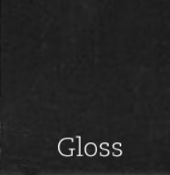
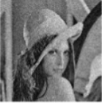

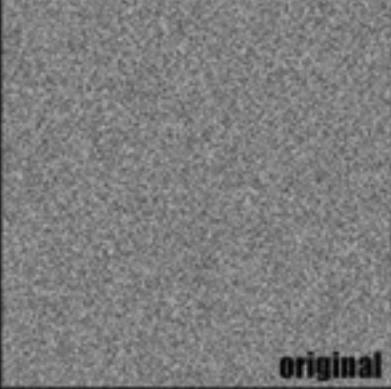
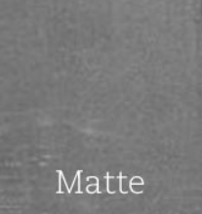
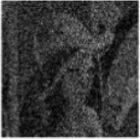

Kurtosis Skewness Variance Entropy
Data Description
Descriptive Analysis
Model Comparison
Conclusion
Notes:
Each predictor, Kurtosis, Skewness, Variance, and Entropy contribute to determine the authentication of the banknote. As you can see the upper image of each predictor is higher value.
Kurtosis -> If kurtosis is higher the image looks like a kind of clean and lighter, but lower kurtosis has some noise in the image
Skewness -> For the skewness, The image is darker and glossier if positively skewed. Lighter and matter if negatively skewed
Variance -> High variance gives you less noise image, but low variance gives you darker and noisy image.
Entropy -> Entropy represents the degree of randomness. So, High entropy means more disordered, and Low entropy means highly ordered. If we apply this concept to the picture, high entropy makes picture more exact with variety of gray colors and low entropy makes picture have just same gray color.

Slide 6
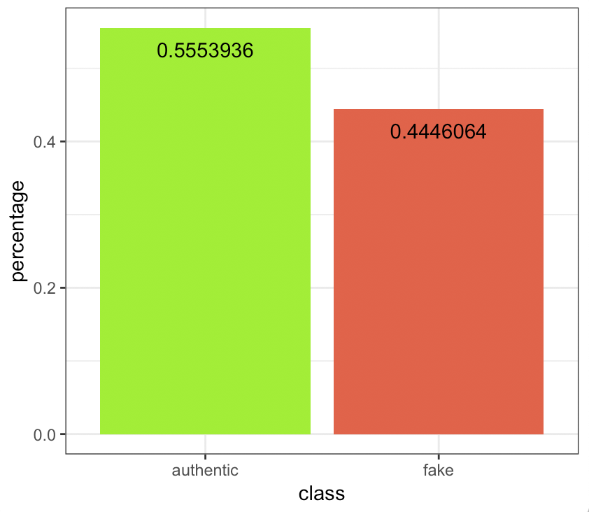
Proportion of Class
Data
Proportion of class
0.75
0.25
Train
Test
Data Description
Descriptive Analysis
Model Comparison
Conclusion
Notes:
In the whole dataset, the authentic cases counts for 55% of the whole observations, and the fake cases counts for 45%. The dataset is pretty balanced.
We divide the whole dataset in to the training and testing dataset. The training dataset randomly selects 75% of observations the whole dataset, and the rest 25% of the dataset are test dataset. We build our models based on the training dataset, and examine the result on the test dataset.

Slide 7
Model Comparison
 | LDA | QDA | Logistic Regression | SVM | RandomForest | Adaboosting
Accuracy | 0.9650146 | 0.9766764 | 0.9854227 | 1 | 0.9941691 | 1
Sensitivity | 1 | 1 | 0.9873418 | 1 | 1 | 1
Specificity | 0.9351351 | 0.9567568 | 0.9837838 | 1 | 0.9891892 | 1
Data Description
Descriptive Analysis
Model Comparison
Conclusion
Notes:
This is our result using all four variables we had in the original dataset.
As you can see, all methods generates a high level of accuracy. They are all more than 95 percent in accraucy.

Slide 8
Model Comparison
 | LDA | QDA | Logistic Regression | SVM | RandomForest | Adaboosting
Accuracy | 0.9650146 | 0.9766764 | 0.9854227 | 1 | 0.9941691 | 1
Sensitivity | 1 | 1 | 0.9873418 | 1 | 1 | 1
Specificity | 0.9351351 | 0.9567568 | 0.9837838 | 1 | 0.9891892 | 1
Data Description
Descriptive Analysis
Model Comparison
Conclusion
Notes:
In the SVM and Adaboosting case, the accuracy is even 100%. However, it’s nearly impossible to reach such a perfect result in the real world.
Then, we try to find out the reason behind this phenomenon.

Slide 9
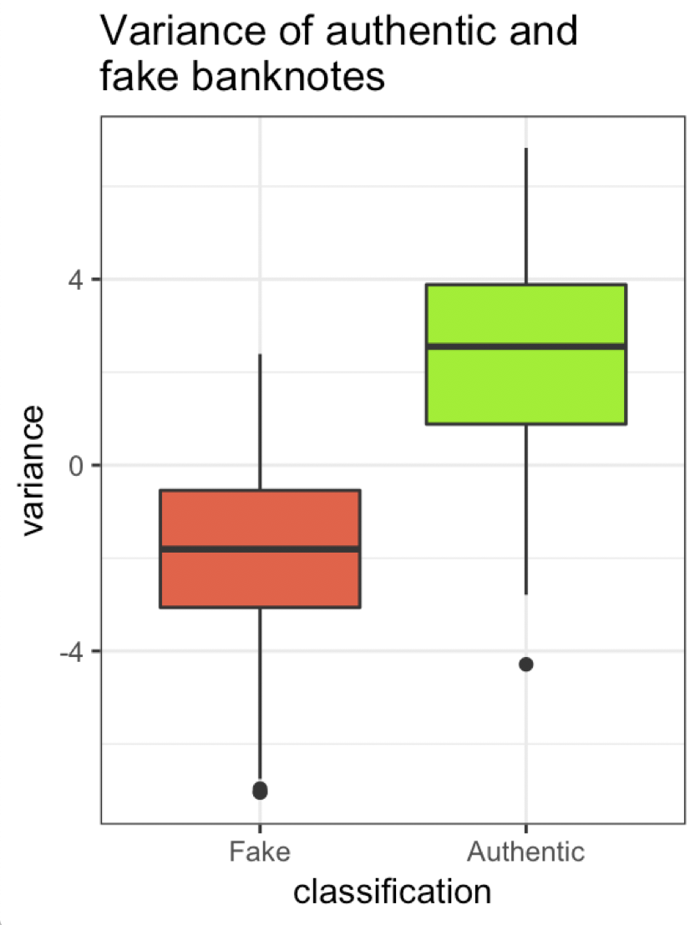
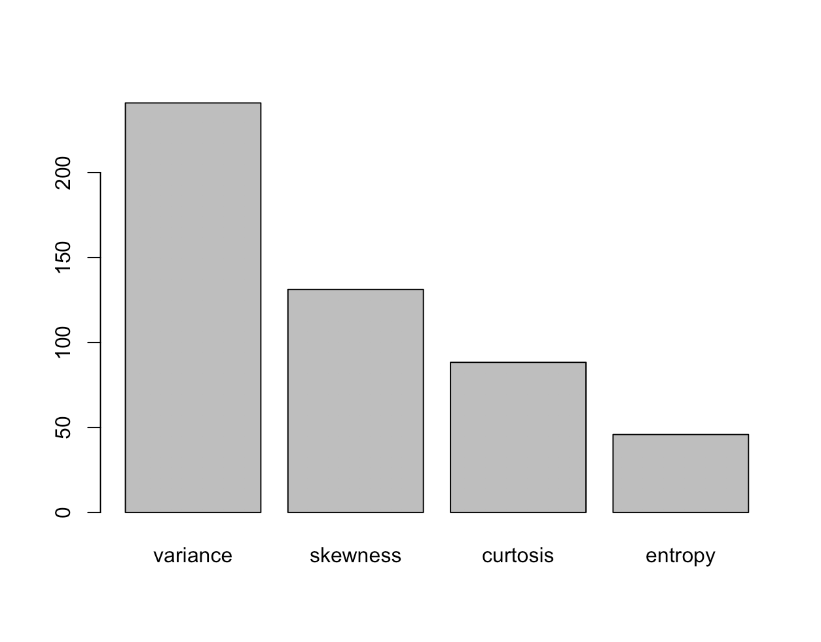
“Variance”
Data Description
Descriptive Analysis
Model Comparison
Conclusion
Notes:
Then, we find that the high level of accuracy is because of one of the predictors, variance.
As you can see on the barplot, variance is super significant when making predictions.
In this boxplot, we can see that there is a huge gap between the variance of fake and authentic banknotes.

Slide 10
“Variance”
Data Description
Descriptive Analysis
Model Comparison
Conclusion
Notes:
If you simply draw a line to manually set a cutoff for variance, it’s really likely you make a really accurate prediction.

Slide 11
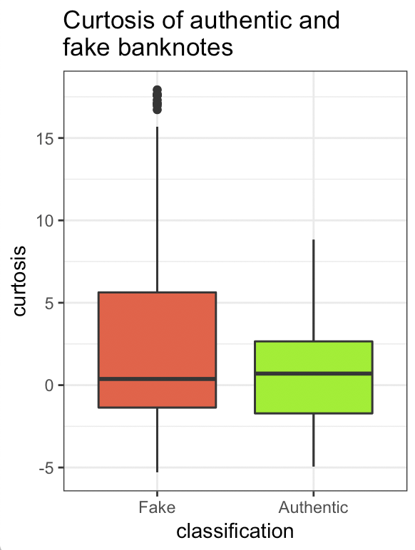
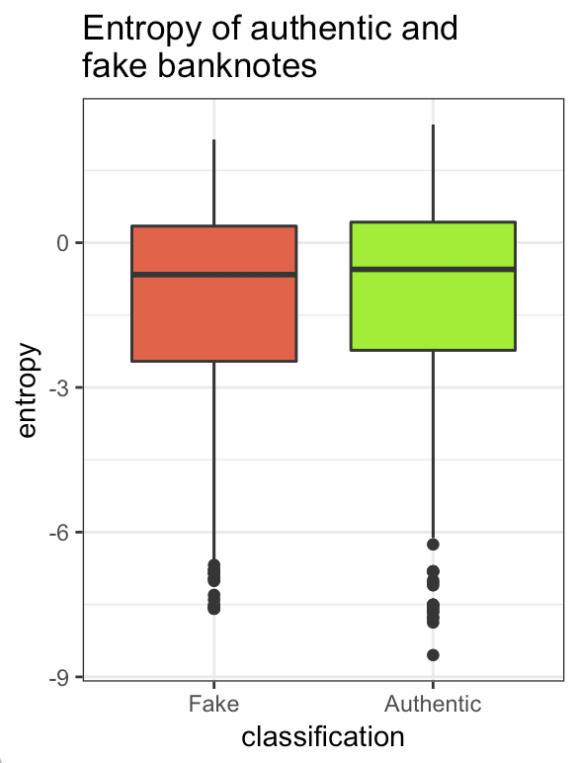
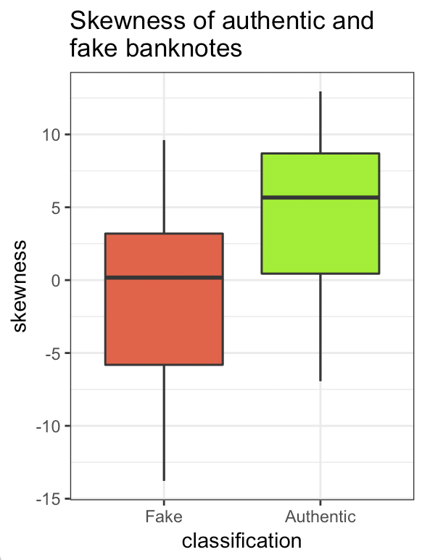
Kurtosis vs Entropy vs Skewness
Data Description
Descriptive Analysis
Model Comparison
Conclusion
Notes:
Then, we decide to try our models after removing the variance. We just used kurtosis, entropy, and skewness when training the model.
According to the boxplot, none of the variables differs really significantly for fake and authentic banknotes.

Slide 12
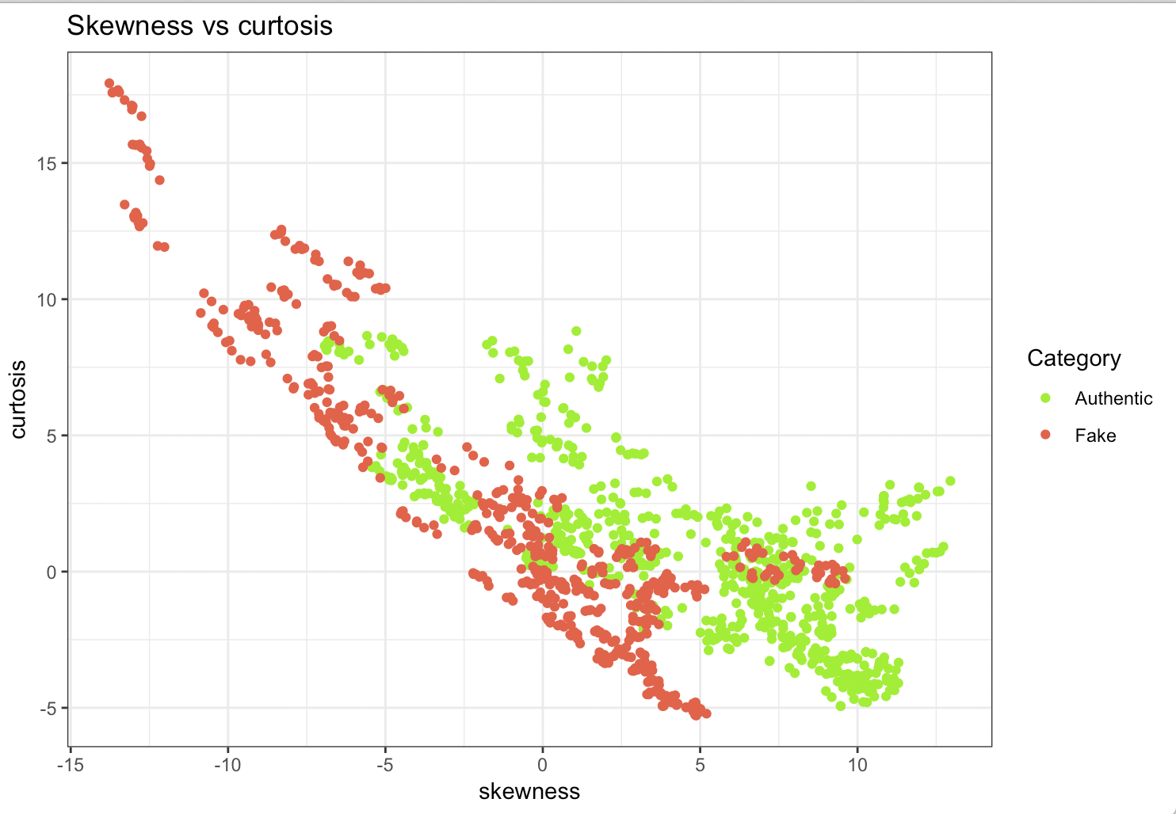
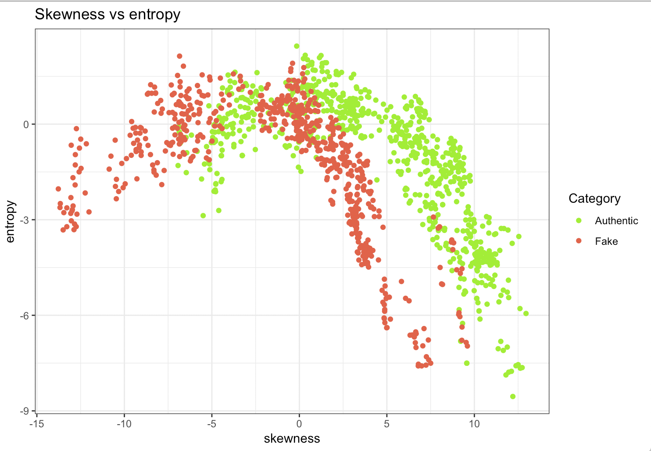
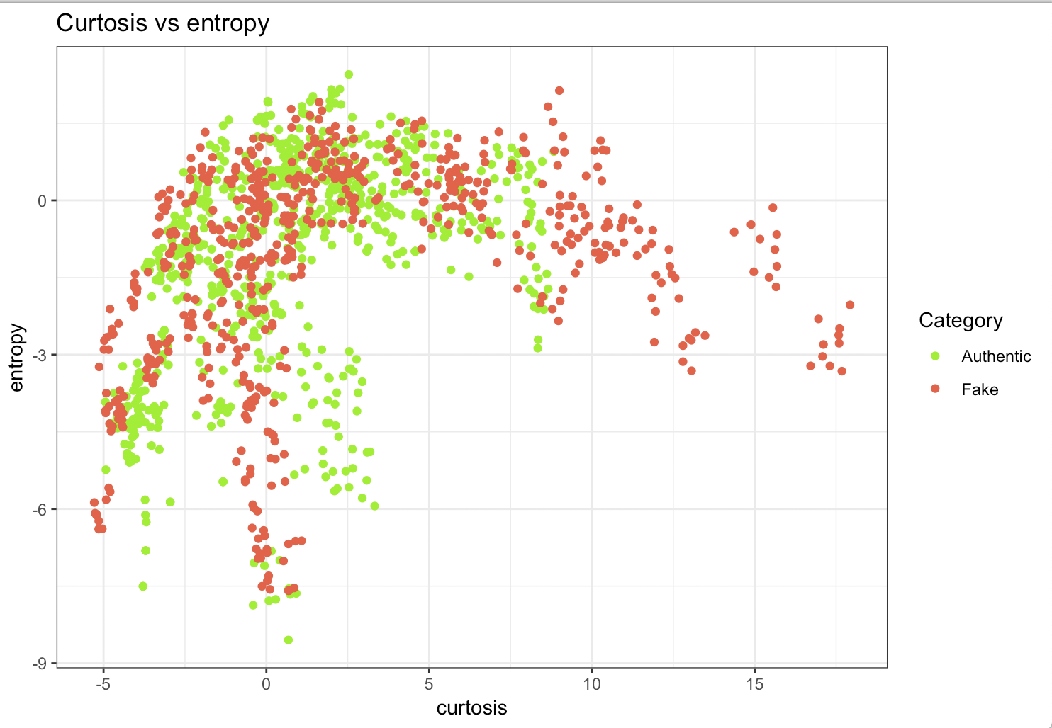
Skewness vs Kurtosis vs Entropy
Data Description
Descriptive Analysis
Model Comparison
Conclusion
Notes:
This is a graph that shows the relationship between each predictors.
As you can see, real banknotes tend to have higher skewness and lower curtosis.

Slide 13
Model Comparison without Variance
 | LDA | QDA | Logistic Regression | SVM | RandomForest | Adaboosting
Accuracy | 0.8250729 | 0.8075802 | 0.8279883 | 0.9533528 | 0.9679300 | 0.8950437
Sensitivity | 0.835443 | 0.778481 | 0.8544304 | 0.943038 | 0.9493671 | 0.8670886
Specificity | 0.8162162 | 0.8324324 | 0.8054054 | 0.9621622 | 0.9837838 | 0.9189189
Data Description
Descriptive Analysis
Model Comparison
Conclusion
Notes:
This is the model comparison without “variance”
We used probability= 0.4 for SVM since the proportion of class = 1 was 0.44.
We can see that the SVM and Random Forest classifier show the highest accuracy, sensitivity and specificity.

Slide 14
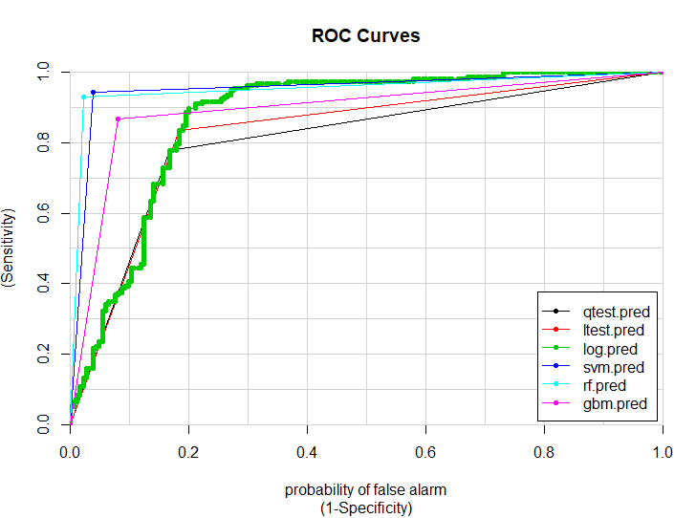
AUROC
QDA | 0.8054567
LDA | 0.8258296
Logistics | 0.8732125
SVM | 0.9526001
Random Forest | 0.9543791
ADA Boosting | 0.8930038
Data Description
Descriptive Analysis
Model Comparison
Conclusion
Notes:
We also compared ROC curve and the table on the left is showing AUC value of each model.

Slide 15
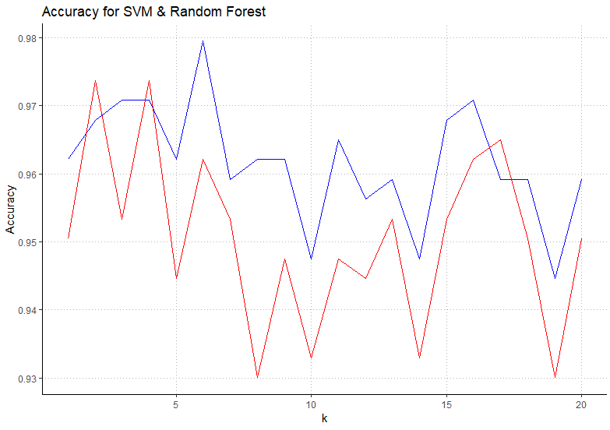
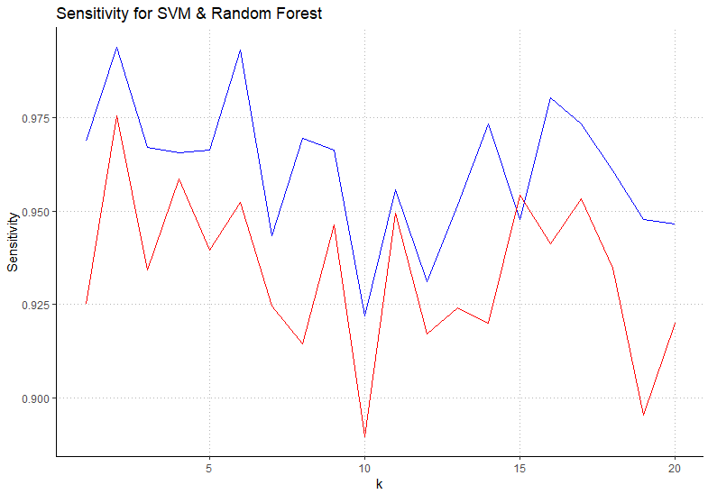
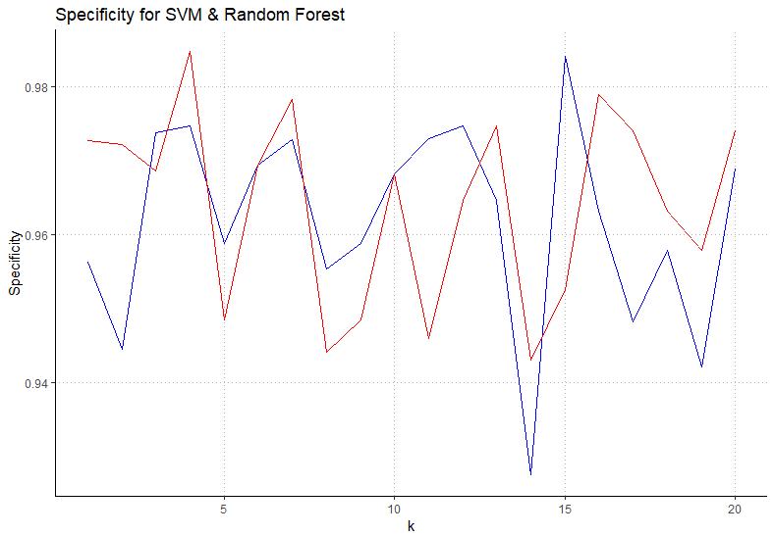
SVM vs Random Forest
SVM -> Blue Line
Random Forest -> Red Line
Data Description
Descriptive Analysis
Model Comparison
Conclusion
Notes:
In order to determine the better classifier between SVM and Random Forest, we repeated training/testing random split process for 20 times.
Based on this result, we’ve selected SVM over Random Forest. Moreover, when it comes to banknote authentication, we place importance on sensitivity over specificity. In other words, true positive, or probability of detection is more important for our dataset.

Slide 16
SVM!!
SVM -> Blue Line
Random Forest -> Red Line
Data Description
Descriptive Analysis
Model Comparison
Conclusion
Notes:
Based on this result, we’ve selected SVM over Random Forest sincewe place importance on sensitivity over specificity. In other words, true positive, or probability of detection is more important for our dataset, authentication of banknote

Slide 17
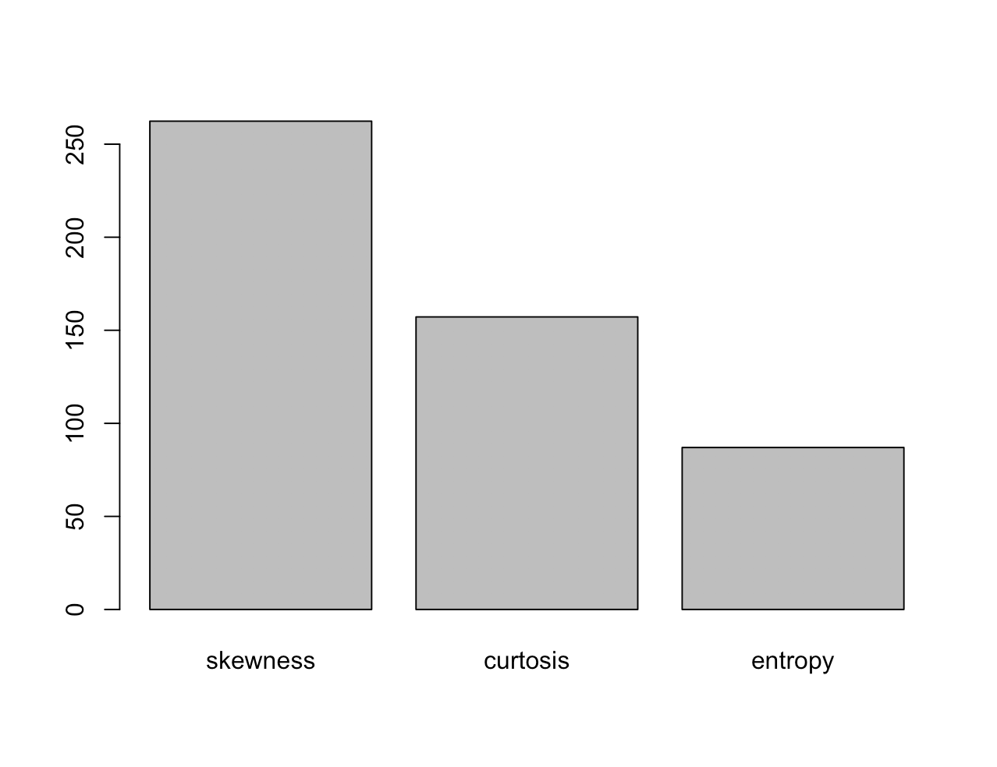
Why does SVM outperform?
It can be paired with kernel trick
Suitable for two-class problem
Suitable for continuous variables
Data Description
Descriptive Analysis
Model Comparison
Conclusion
Notes:
It allow us to create appropriate feature space by tuning kernel and found that kernel “radial” is the most adequate one
SVM is more suitable for two-class problem whereas random forest is better for multiclass problem. Our class is two class problem, which represent 1 = fraud and 0 = authentic banknote
SVM is more suitable for continuous variables whereas random forest is better for discrete variables.
SVM maximizes the "margin" and thus relies on the concept of "distance" between different points

Slide 18
Drawbacks of the Random Forest
Pros
Random forest is very efficient for very very large datasets. It is a bagging technique. It more like a Classification/Regression tree.
Prevent overfitting of a single decision tree
Cons
Not accurate for new samples
It's main drawbacks include the poor performance on imbalanced data (rare outcomes or rare predictors) and lack of an interpretable model. For balanced data and pure prediction purposes, it's pretty good in general, especially as it's easy to fit within a MapReduce framework.
Data Description
Descriptive Analysis
Model Comparison
Conclusion

Slide 19
Drawbacks
Choosing appropriate kernel is tricky
Long training time on large dataset.
Doesn’t provide probability estimates
Difficult to understand and interpret the final model
SVM algorithm is that it has several key parameters that need to be set correctly to achieve the best classification results for any given problem
Data Description
Descriptive Analysis
Model Comparison
Conclusion
Notes:
Choosing appropriate kernel is tricky, we when we performed SVM, we had to try different kernel to find the best kernel since there is no tuning function for finding the best kernel. So we had to try several different kernel such as linear and polynomial until we found the best one
If you have large dataset it takes longer to train the model compare to other classifier. If we had to repeat the process more than 20 times, it would take longer
Unlike we used the probability 0.4 in Random Forest according to the class proportion, SVM doesn’t provide probability estimates.
It was also hard to understand and interpret the final model such as variable weights and individual impact.

Slide 20
Question?

